Slide 1
TONE GROUP (OR TONE UNIT)
Student: Areli Luna Navarro
Teacher: Toni Marrufo.

Slide 2
TONE
The overall behavior of pitch, i.e., the different changes or movements the pitch can show in a syllable. The different tones make the voice go upwards and downwards in a tone group.
TYPES OF TONES
Fall (A Falling Tone)
Low Rise (A Rising Tone)
High Rise (A Rising Tone)
Fall Rise (followed by Fall)

Slide 3

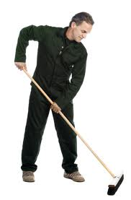
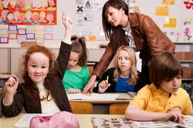
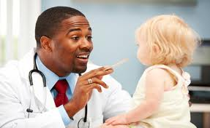
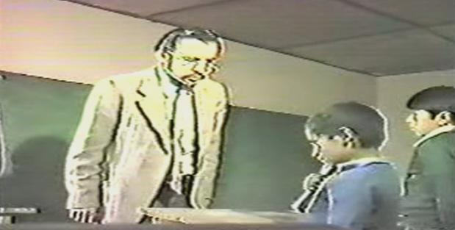
Fall (A Falling Tone)
Where is the PENcil?
I'll report you to the HEADmaster
· I've spoken with the CLEAner.
Go and see a DOCtor.
Take a SEAT.

Slide 4
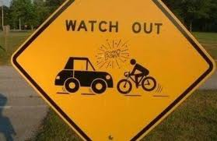
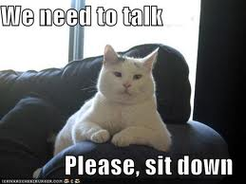
Requests or orders have a falling tone too.
Exclamations
Call him IN.

Slide 5
Yes/No questions and tag questions seeking or expecting confirmation can be uttered with a falling tone. And the response to it may be lengthened. Consider the following example:
a)You like it, DON'T you?
b) YEES.
In a Yes/No question structure, if the speaker uses a falling tone, we assume that he already knows the answer, or at least he is sure that he knows, and the purpose of asking the question, as far as the speaker is concerned, is to put the answer on record. In the following exchange, the speaker is sure to get a 'Yes' answer from the addressee:
a) Have you MET him?
b) YES.

Slide 6


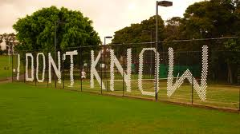
Low Rise (A Rising Tone)
·
A) Isn't he NICE

Slide 7

Compare the above example with the following example, which is uttered with a falling tone, and which can only have one appropriate answer in the context:
a) Isn't he NICE
b) YES.
Other examples which are uttered with a rising tone are:
· Do you want some COFfee?
· Do you take CREAM in your coffee?

Slide 8
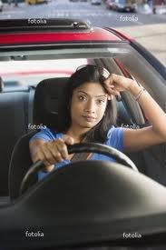
High Rise (A Rising Tone)
a) I'm taking up TAxidermy this autumn.
b) Taking up WHAT? (clarification)
a) She passed her DRIving test.
b) She PASSED? (disbelief)

Slide 9
Fall Rise (followed by Fall)
· Private enterPRISE / is always EFficient.
· A quick tour of the CIty / would be NICE.
· PreSUmably / he thinks he CAN.
· Usually / he comes on SUNday.
· When I passed my REAding test / I was VEry happy.
· If you SEE him / give my MESsage

Slide 10
· I WON'T deliver the goods / unless I receive the PAYment.
· The moon revolves around the EARTH / as we ALLknow.
· Private enterprise is always EFficient / whereas public ownership means INefficient.
· He joined the ARmy / and spent all his time in ALdershot.
· My sister who is a NURSE / has ONE child.

Slide 11
Fall-rise + Low Rise
· If I HELPED you / would you try aGAIN?
· Despite its DRAWbacks / do you favor it or NOT?

Slide 12
Fall + Fall
It's a bit TOO good to be true / ISN'T it?
Ann said she'd help as much as she COULD / NATUrally.
She's 28 years OLD / and lives in GiPPSland

Slide 13

THANK
S

